Slide 1

Computer Networks Self Study
File Sharing Web Application to Implement Bit Torrent Protocol
Anshul Agrawal 1RV17CS021
Arpit Kumar 1RV17CS024
Chanakya Hosamani 1RV17CS035
Chetan Badiger 1RV17CS036

Slide 2
Problem Statement
Mostly before 1980’s most of the web was based on a client server model. In 1980s the first peer to peer network was deployed with stand-alone PC’s. The speed was limited due to the one system’s connection(the central server).Also the robustness was very less as the whole system is dependent on just one central system. Along with the increased user base, the centralized system had to be more advanced in terms of computing power.The failure of the central server led to the failure of the whole system.Hence , there was a need to move to a decentralized method of P2P file and data sharing.Compared to the more common server-client solution, a peer-to-peer approach has several advantages including increased robustness and resource providing, such as bandwidth, storage space and computing power, by peers. One area where robustness and utilization of resources is important is file distribution, especially of large files.

Slide 3
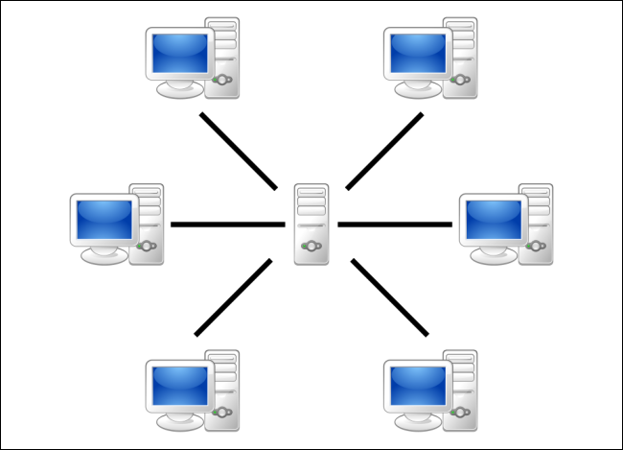
Introduction
Compared to the more common server-client solution, a peer-to-peer approach has several advantages including increased robustness and resource providing, such as bandwidth, storage space and computing power, by peers. One area where robustness and utilization of resources is important is file distribution, especially of large files.
When you download a web page, your computer connects to the web server and downloads the data directly from that server. Each computer that downloads the data downloads it from the web page’s central server. This is how much of the traffic on the web works.

Slide 4
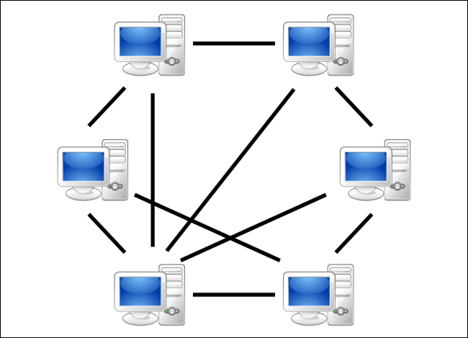
BitTorrent is a peer-to-peer protocol, which means that the computers in a BitTorrent “swarm” (a group of computers downloading and uploading the same torrent) transfer data between each other without the need for a central server.
Peer to Peer Network
Traditionally, a computer joins a BitTorrent swarm by loading a .torrent file into a BitTorrent client. The BitTorrent client contacts a “tracker” specified in the .torrent file. The tracker is a special server that keeps track of the connected computers. The tracker shares their IP addresses with other BitTorrent clients in the swarm, allowing them to connect to each other.

Slide 5
Once connected, a BitTorrent client downloads bits of the files in the torrent in small pieces, downloading all the data it can get. Once the BitTorrent client has some data, it can then begin to upload that data to other BitTorrent clients in the swarm. In this way, everyone downloading a torrent is also uploading the same torrent. This speeds up everyone’s download speed. If 10,000 people are downloading the same file, it doesn’t put a lot of stress on a central server. Instead, each downloader contributes upload bandwidth to other downloaders, ensuring the torrent stays fast.
BitTorrent may be primarily used for piracy at the moment, as its decentralized and peer-to-peer nature are a direct response to efforts to crack down on peer-to-peer networks with central points of failure. However, BitTorrent is a tool with legitimate uses in the present — and many other potential uses in the future.

Slide 6
Literature Review
Tyson, J. (2018). How the Old Bittorent Worked. [online] HowStuffWorks. Available at: https:/computer.howstuffworks.com/Bittorent1.htm
Khan, M. (2018). Peer-to-Peer Networks. [online] Getrevising.co.uk. Available at: https:/getrevising.co.uk/grids/peer_to_peer_networks
https://www.howtogeek.com/141257/htg-explains-how-does-bittorrent-work/
Oluwatosin, H. (2014). Client-Server Model. IOSR Journal of Computer Engineering https://pdfs.semanticscholar.org/e1d2/133541a5d22d0ee60ee39a0fece970a4ddbf.pdf

Slide 7
Features
Download multiple torrents simultaneously, efficiently
Exposes files as streams
Fetches pieces from the network on-demand so seeking is supported (even before torrent is finished)
Seamlessly switches between sequential and rarest-first piece selection strategy
While less efficient than a pure binary encoding,[bencoding is simple and (because numbers are encoded as text in decimal notation) is unaffected by endianness, which is important for a cross-platform application like BitTorrent.
It is also fairly flexible, as long as applications ignore unexpected dictionary keys, so that new ones can be added without creating incompatibilities.

Slide 8
ARCHITECTURE DIAGRAM
Static Webpage using Node.js, Html and CSS.
Web Programming
Bittorent Protocol using WebRTC.
Computer
Networks
Bencode Parser
Compiler
Design

Slide 9
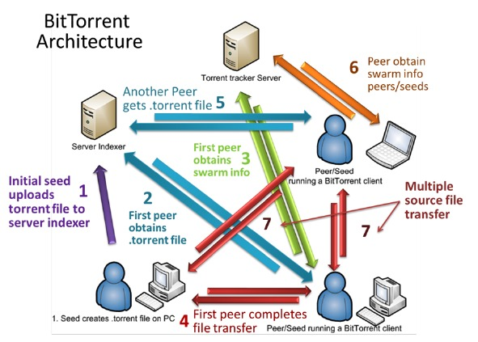

Slide 10
Web Application
The interface of the application is built using web tools such as HTML, CSS, ReactJS which provides a cumberless way for the users to create a torrent client. NodeJS forms the backbone for the application which assesses the input provided by the users.
HTML: Hypertext Markup Language in order to create buttons , tables to upload and download files from the website.
CSS : Cascading Style Sheets are used in order to decorate the above mentioned HTML elements so that they are presented to the user in a attractive and convenient manner.
ReactJS: ReactJS is used to make the UI much more sophisticated to enhance the aesthetic look of the application
NodeJS: As an asynchronous event-driven JavaScript runtime, Node.js is designed to build scalable network applications. It forms the framework on which the entire application runs.

